Slide 1
Hip Flexors
Iliopsoas
  Iliacus and Psoas muscles

Slide 2
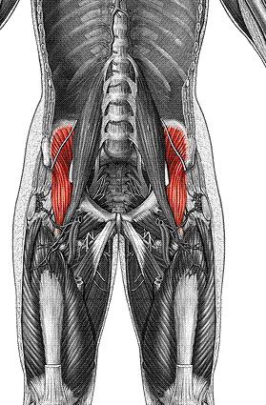
Iliacus
O: ilium
I: femur
F: flex thigh

Slide 3
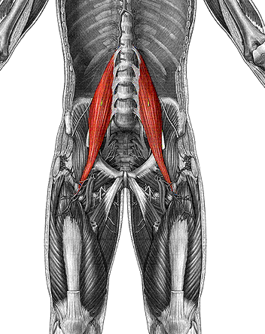
Psoas major
O: vertebrae
I: femur
F: flex thigh

Slide 4
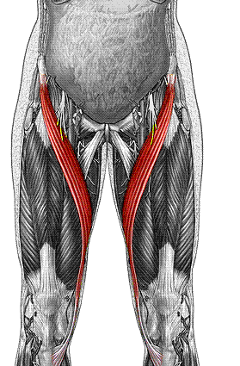
Sartorius
O: ilium (A.S.I.S.)
I: tibia
F: flex thigh & leg

Slide 5
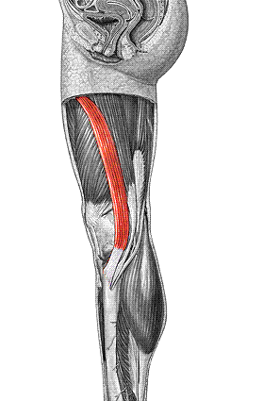
Gracilis
O: pubis
I: tibia
F: adduct thigh,
flex leg

Slide 6
Adductors

Slide 7
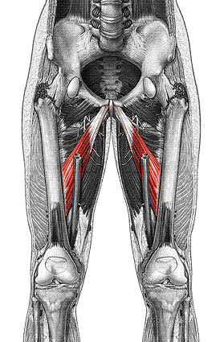
Adductor longus
O: pubis
I: femur
F: adduct, flex,
laterally rotate thigh

Slide 8
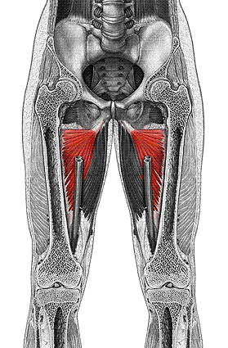
Adductor magnus
O: ischium & pubis
I: femur
F: adduct, flex,
laterally rotate thigh

Slide 9
Leg Flexors
Quadriceps:
  Rectus femoris
  Vastus lateralis
  Vastus intermedius
  Vastus Medialis

Slide 10
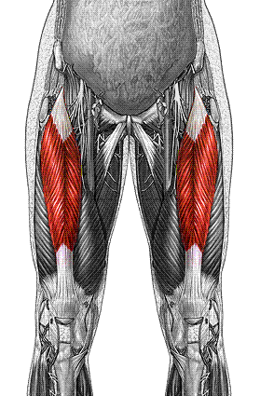
Rectus femoris
O: ilium (A.I.I.S.)
I: tibia via patella
F: flex thigh & extend leg

Slide 11
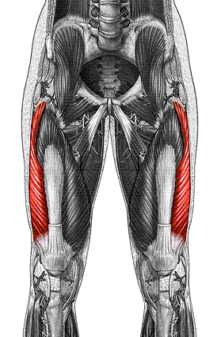
Vastus lateralis
O: femur
I: tibia via patella
F: extend leg

Slide 12
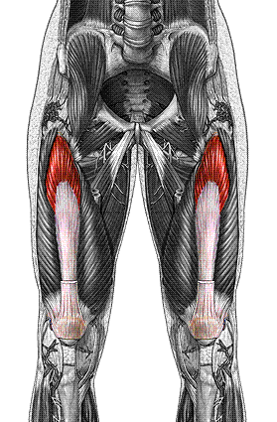
Vastus intermedius
O: femur
I: tibia via patella
F: extend leg

Slide 13
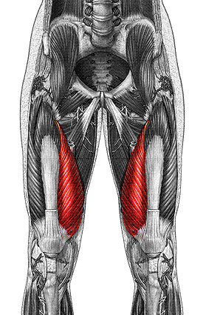
Vastus medialis
O: femur
I: tibia via patella
F: extend leg

Slide 14
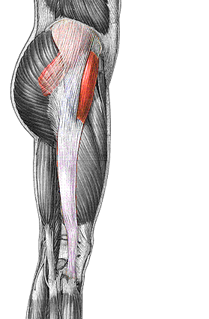
Tensor fascia lata
O: ilium
I: iliotibial band
F: abduct & flex thigh

Slide 15
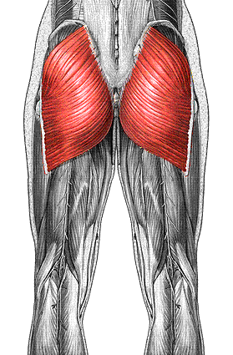
Gluteus maximus
O: ilium & sacrum
I: femur
F: extend thigh

Slide 16
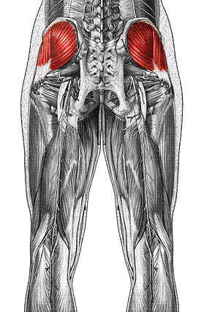
Gluteus medius
O: ilium
I: femur
F: abduct & medially
rotate thigh

Slide 17
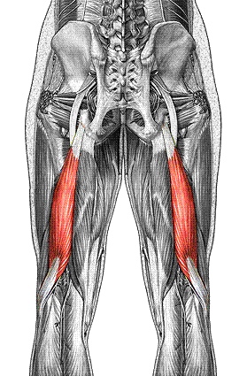
Biceps femoris
O: ischial tuberosity & femur
I: tibia & fibula
F: extend thigh & flex leg

Slide 18
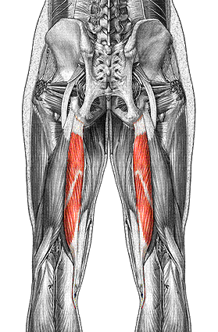
Semitendinosus
O: ischial tuberosity
I: tibia
F: extend thigh & flex leg

Slide 19
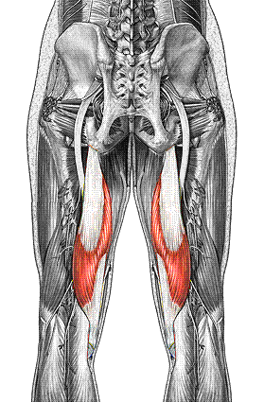
Semimembranosus
O: ischial tuberosity
I: tibia
F: extend thigh & flex leg

